Slide 1
Project Presentation
On
Secure Online Examination System using AI Proctoring
Dilpreet Singh 2210991516
Kartik Thakur 220991760
Sunaina 2210990875
Supervised By
Dr. Isha Kansal
Department of Computer Science and Engineering,
Chitkara University, Punjab

Slide 2
Content Table
S. No. | Title | Page No.
1 | Introduction to the project | 3
2 | Problem Statement | 4
3 | Solution | 5
4 | Features | 6
5 | Software and Hardware Requirement Specification | 7
6 | Program’s Structure Analyzing and GUI Constructing | 9
7 | References | 13
2

Slide 3
Introduction to Project
1 Introduction
The rapid evolution of digital education has significantly increased the demand for reliable and secure online examination systems. However, conventional online assessment platforms lack robust mechanisms to prevent cheating and ensure academic integrity. This project proposes a Secure Online Examination System integrated with AI-based proctoring that leverages advanced technologies such as computer vision, machine learning, and real-time monitoring to detect and prevent malpractice.
The system continuously analyzes candidate behavior through webcam and microphone inputs to identify anomalies such as multiple face detection, absence from screen, unusual head or eye movements, and background disturbances. It generates real-time alerts and records evidence for post-exam review. The proposed system ensures a fair, transparent, scalable, and cost-effective solution suitable for modern educational institutions and remote learning environments.
3

Slide 4
Problem statement
With the global shift toward online learning, especially accelerated by events like the COVID-19 pandemic, educational institutions face significant challenges in conducting secure and credible examinations remotely. Traditional methods of invigilation are either resource-intensive or ineffective in a virtual environment.
Existing online exam systems primarily depend on trust or limited monitoring, making them vulnerable to cheating practices such as impersonation, use of unauthorized materials, and collaboration with others. Artificial Intelligence, particularly in the domains of computer vision and behavioral analytics, provides a powerful solution to automate proctoring tasks.
By integrating AI into online examinations, institutions can achieve real-time monitoring, automated anomaly detection, identity verification, and evidence-based evaluation. This project aims to bridge the gap between accessibility and security in digital assessments.

Slide 5
Solution / Proposed System
The proposed system is a web-based platform that combines an online examination interface with an AI-powered proctoring engine to provide a comprehensive solution for secure assessments. Users begin by registering and logging into the system through a secure authentication process, followed by identity verification using facial recognition technology. Once the examination starts, the system continuously captures and processes video and audio streams from the candidate’s device. Advanced AI algorithms analyze these inputs in real time to detect patterns such as eye gaze direction, head movement, and background noise, which may indicate potential cheating attempts. The system also monitors browser activity to identify actions like tab switching or accessing unauthorized resources. Any suspicious activity triggers immediate alerts and is logged with timestamps, while the entire session is recorded and securely stored for post-examination analysis. An administrative dashboard enables instructors to monitor live sessions, review flagged events, and generate detailed reports, ensuring a transparent and efficient examination process.

Slide 6
Features
Secure user authentication and role-based access control
Facial recognition for identity verification
Continuous live video and audio monitoring
Detection of eye and head movements
Identification of multiple faces in the frame
Tracking of browser activity to prevent tab switching
Automated alert generation and logging for suspicious activities
Session recording for evidence collection
Centralized administrative dashboard for monitoring and reporting
Secure examination interface with restrictions on:

Slide 7
Software and Hardware Requirement
2 Software and Hardware Requirement Specification
2.1 Methods
Agile development methodology was used. Weekly sprints ensured iterative development, testing, and feedback incorporation.
2.2 Programming / Working Environment
Frontend Development
Built using React.js for dynamic UI
Styled with Tailwind CSS for responsive design
Backend Development
Implemented using Node.js
Uses Express.js for server-side logic and API handling
Database
MongoDB used for storing user data, Examination records, activity logs

Slide 8
Artificial Intelligence
OpenCV for image processing (face detection, movement tracking)
TensorFlow for machine learning model development and inference
Real-Time Communications
Socket.io for Live monitoring and Instant alert generation
Cloud Storage
Cloudinary / AWS used for secure storage of recorded media

Slide 9
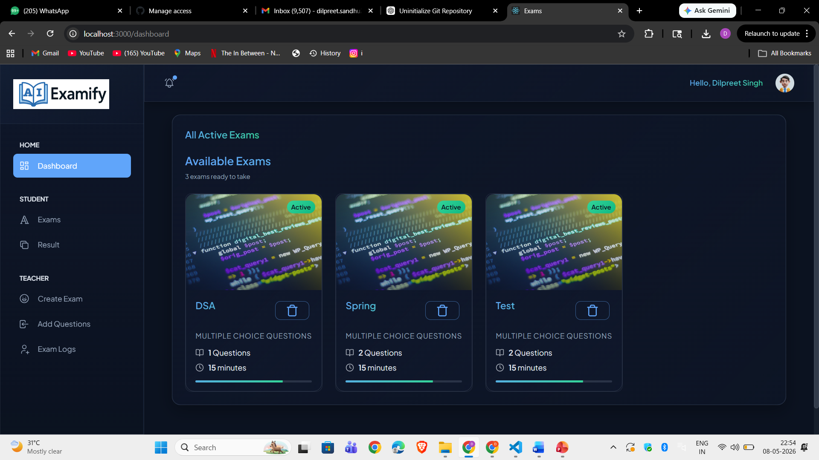
Program’s Structure Analyzing and GUI Constructing
Home Page

Slide 10
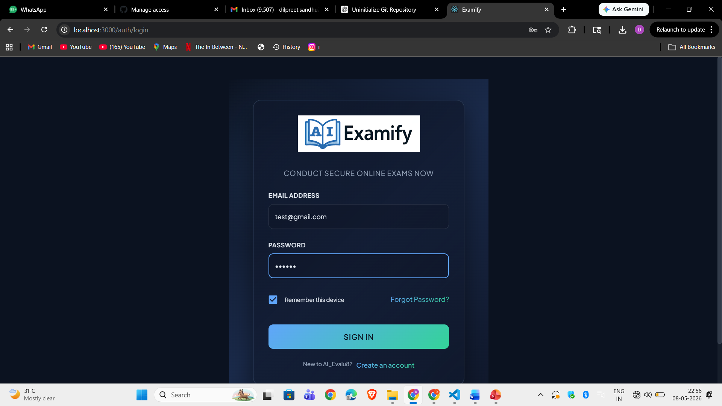
Login Page

Slide 11
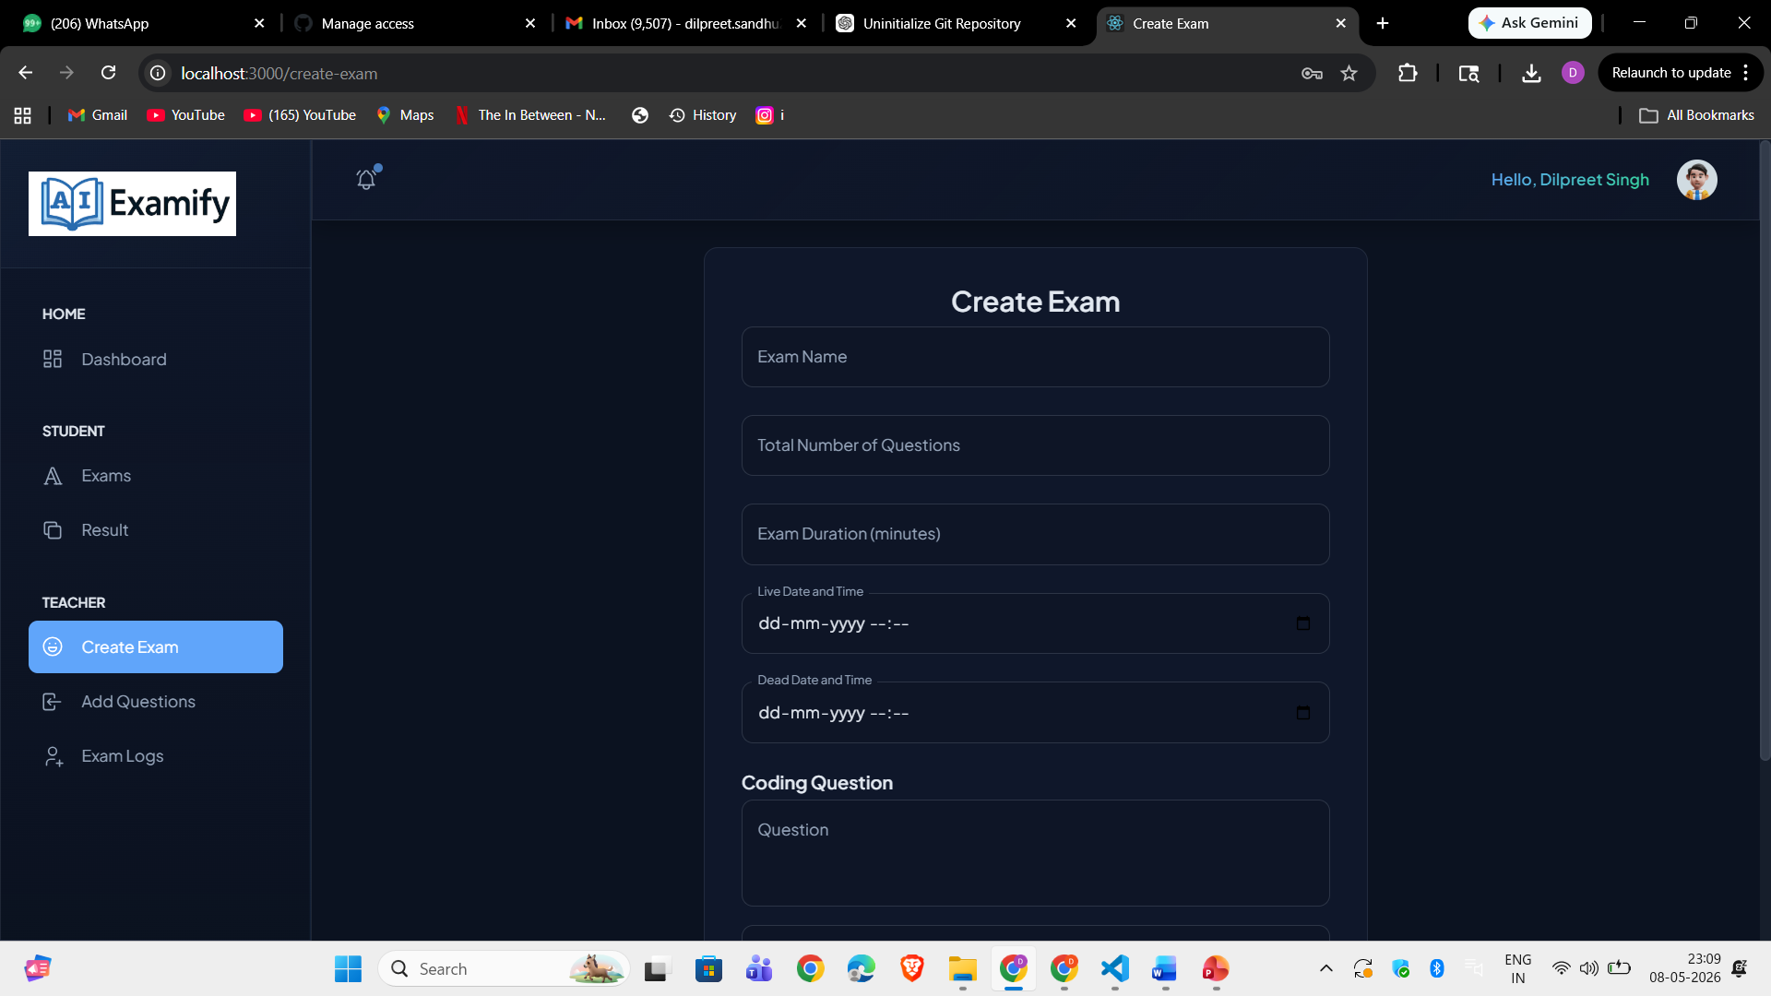
Image

Slide 12
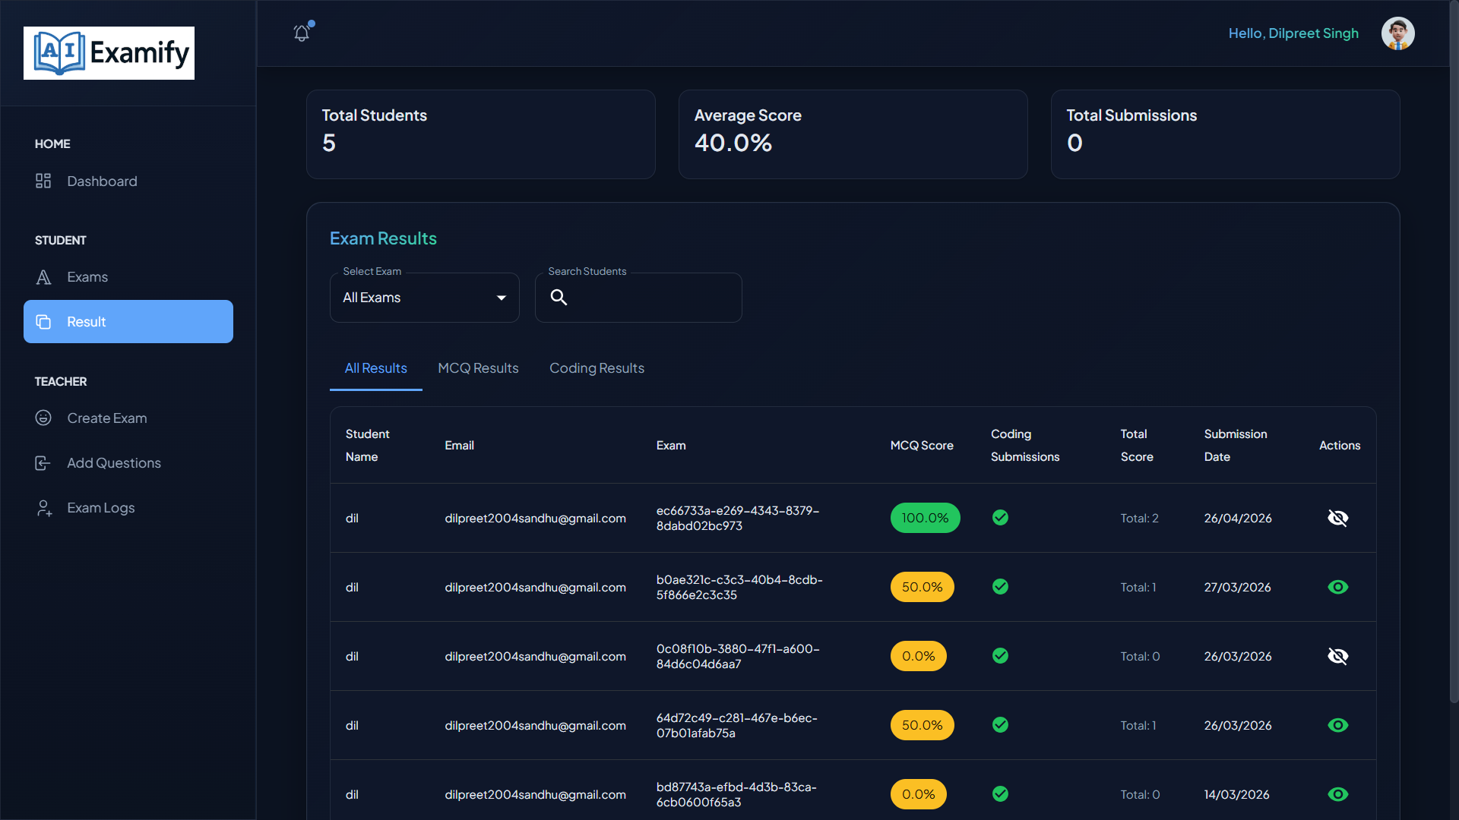
Image

Slide 13
References
React.js Official Documentation: https://reactjs.org/
MongoDB Developer Guides: https://www.mongodb.com/docs/
Node.js Official Documentation: https://nodejs.org/en/docs/
GitHub Docs - Getting Started: https://docs.github.com/en/get-started

Slide 14


